Slide 1
Capstone Project
Hotel Booking Analysis Submitted by Samara Reddy (Individual)

Slide 2
Contents:
Problem Statement
Data Summary
Cleaning the Dataset
Exploratory Data Analysis
Results
Conclusions

Slide 3
Problem Statement
Given data set contains booking information for a city hotel and a
resort hotel, and includes information such as when the booking
was made, length of stay, the number of adults, children, and/or
babies, and the number of required parking spaces, among other
things.
To Explore and analyze the data to discover important factors that govern the bookings.

Slide 4
Data Summary
For staring analysing the data it’s very important to understanding our data. So we had hotel Booking analysis data. Which had 119390 rows and 32 columns. So let’s understand this 32 columns.
Details of Columns
hotel : Resort Hotel or City Hotel
is_canceled : Value indicating if the booking was canceled (1) or not (0) lead_time : Number of days that elapsed between the entering date of the booking and the arrival date
arrival_date_year : Year of arrival date
arrival_date_month : Month of arrival date
arrival_date_week_number : Week number of year for arrival date arrival_date_day_of_month : Day of arrival date
stays_in_weekend_nights : Number of weekend nights

Slide 5
stays_in_week_nights : Number of week nights.
adults : Number of adults
children : Number of children
babies : Number of babies
meal : Type of meal booked.
country : Country of origin.
market_segment : Market segment designation. (TA/TO)
distribution_channel : Booking distribution channel.(T/A/TO)
is_repeated_guest : is a repeated guest (1) or not (0)
previous_cancellations : Number of previous bookings that were cancelled by the customer prior to the current booking
previous_bookings_not_canceled : Number of previous bookings not cancelled by the customer prior to the current booking
reserved_room_type : Code of room type reserved.
assigned_room_type : Code for the type of room assigned to the booking.

Slide 6
booking_changes : Number of changes made to the booking from the moment the booking was entered on the PMS until the moment of check-in or cancellation deposit_type : No Deposit, Non Refund , Refundable.
agent : ID of the travel agency that made the booking
company : ID of the company/entity that made the booking .
days_in_waiting_list : Number of days the booking was in the waiting list before it was confirmed to the customer
customer_type : type of customer. Contract,Group,transient,Transient party.
adr : Average Daily Rate as defined by dividing the sum of all lodging transactions by the total number of staying nights
required_car_parking_spaces : Number of car parking spaces required by the customer
total_of_special_requests : Number of special requests made by the customer (e.g. twin bed or high floor)
reservation_status : Reservation last status

Slide 7
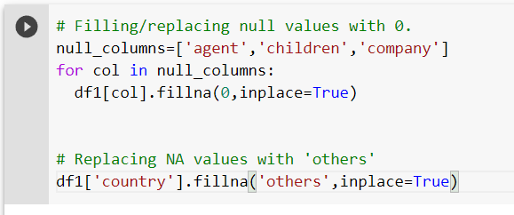
Cleaning the Dataset
There are four columns having Null values:
1. Company - 112593
2. Agent - 16340
3. Country - 488
4. Children – 4
Dealing with null values:
Filled Null values in children, company, agent columns with zero value in respective columns and others in country column.

Slide 8
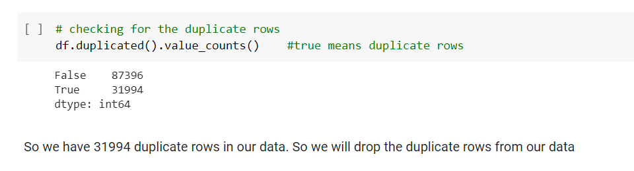
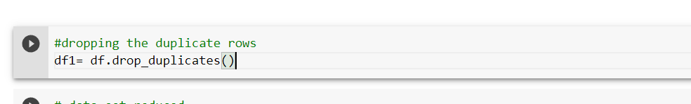
Handling Duplicates: Data had 31994 duplicates values. So we dropped it from the data.

Slide 9
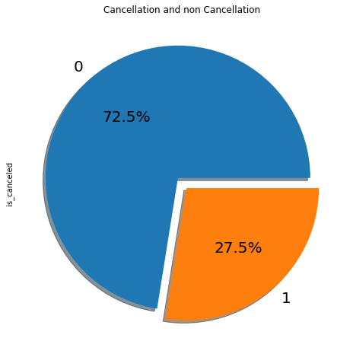
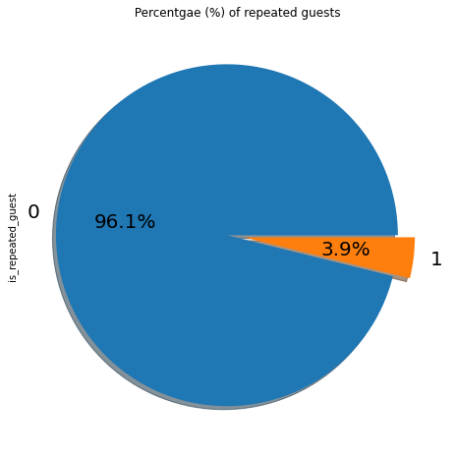
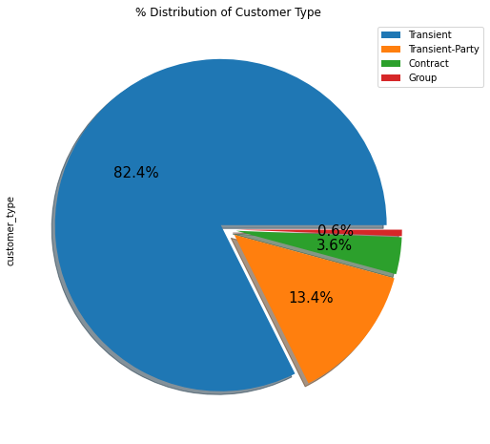
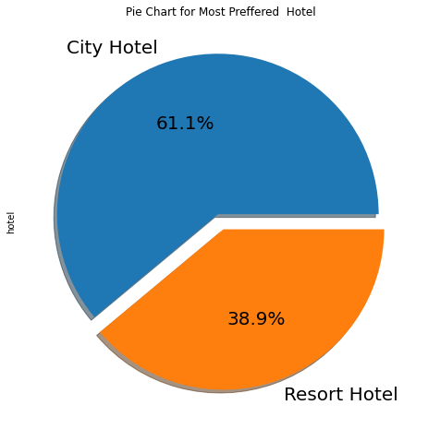
Exploratory Data Analysis
Results:
City hotels is the most preferred hotel type by the guests. We can say City hotel is the busiest hotel
27.5 % bookings were got cancelled out of all the bookings.
Only 3.9 % people were revisited the hotels. Rest 96.1 % were new guests. Thus retention rate is low.
Most of the customers/guests were Transient type(82.4%). And transient party were 13.4% and 0.6 belongs to group. Remaining guests belongs to Contract type.

Slide 10
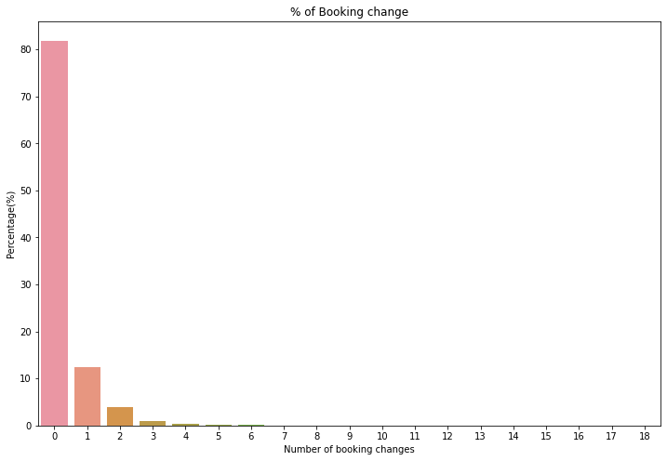
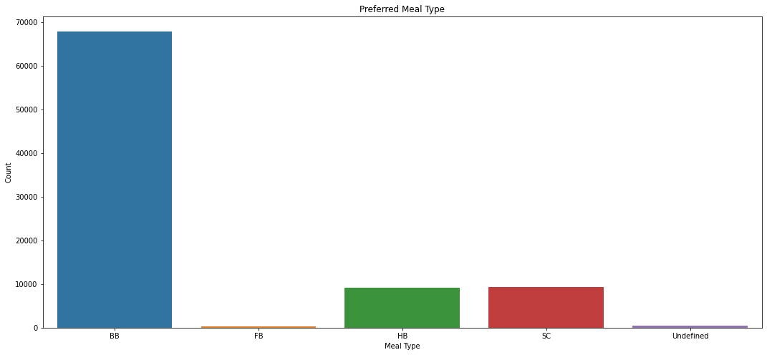
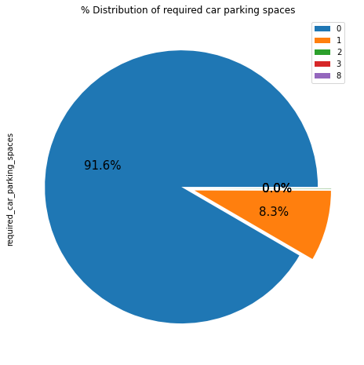
EDA
Results: The percentage of 0 changes made in the booking was more than 82 %. Percentage of Single changes made was about 10%. BB( Bed & Breakfast) is the most preferred type of meal by the guests. Full Board i.e. FB is least preferred. HB (Half Board) and SC(Self Catering) are equally preferred. Most of the customers(91.6%) do not require car parking spaces. Only 8.3 % people required only 1 car parking space.

Slide 11
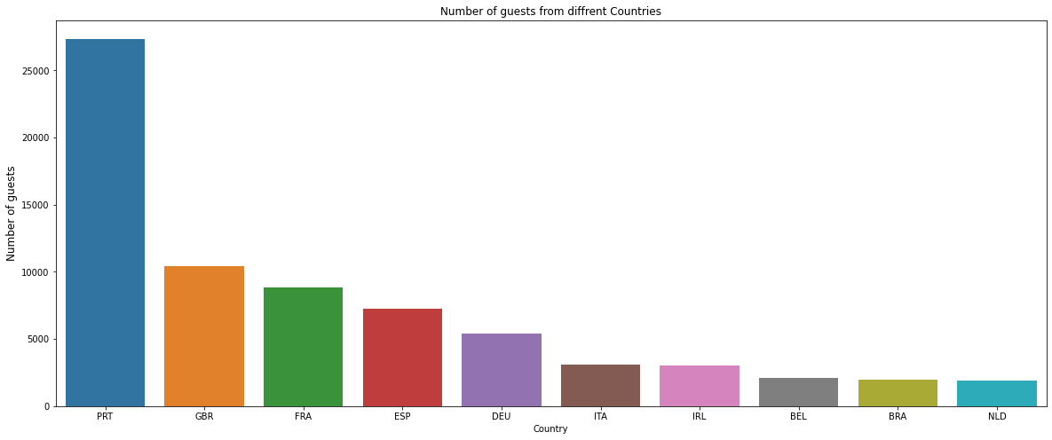
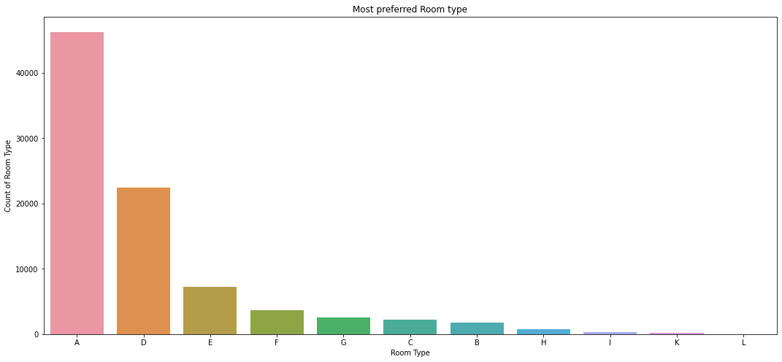
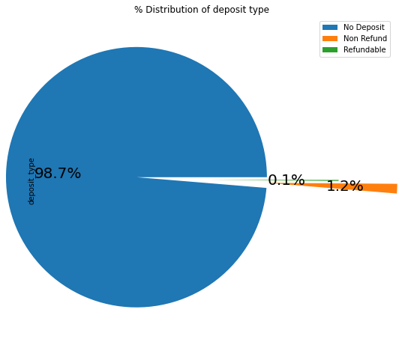
EDA
Results: Most of the guests are coming from portugal i.e more 25000 guests are from Portugal. After Portugal, GBR(Great Brittan),France and Spain are the countries from where most of the guests came And the most preferred Room type is "A”. Second most preferred is ‘D’. Almost 98.7% of the guests prefer ‘No deposit’ type of criterion.

Slide 12
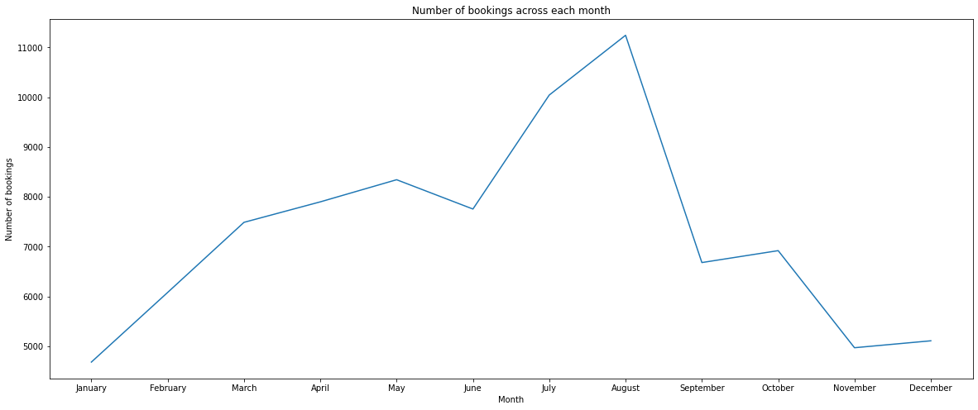
EDA
Results:
As we saw in the above both images August and July months had the most Bookings. Summer vacation can be the reason for the bookings.
 | Arrival month | Count
4 | January | 4685
3 | February | 6083
7 | March | 7489
0 | April | 7900
8 | May | 8344
6 | June | 7756
5 | July | 10043
1 | August | 11242
11 | September | 6682
10 | October | 6921
9 | November | 4973
2 | December | 5112

Slide 13
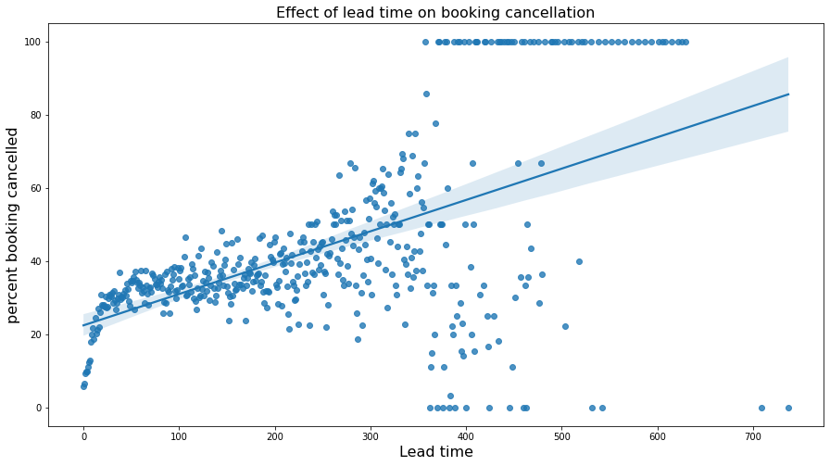
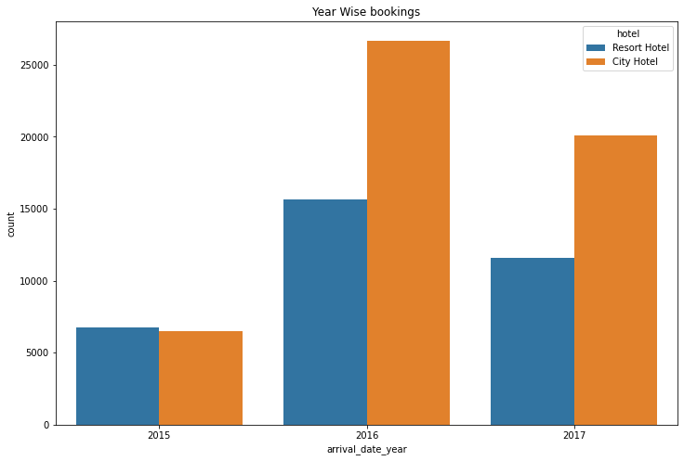
EDA
Results:
‘There is likelihood of lesser correlation between lead time time and booking cancellation. So more lead time is not correlated to cancellation of booking.
2016 had the highest bookings.
2015 had less 7000 bookings.
overall City hotels had the most of the bookings.

Slide 14
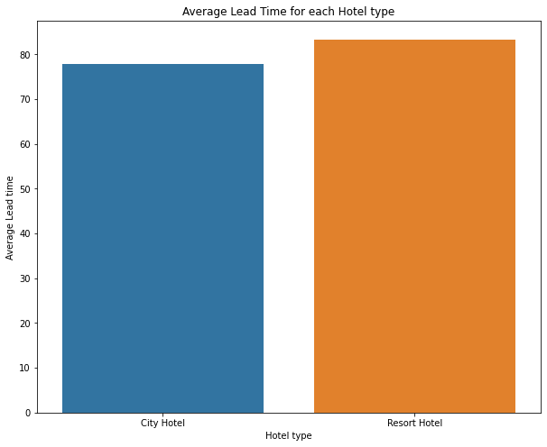
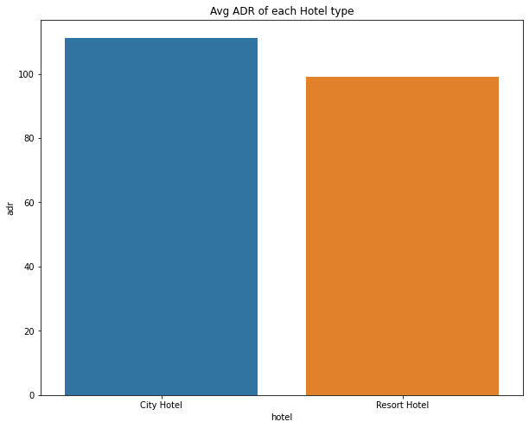
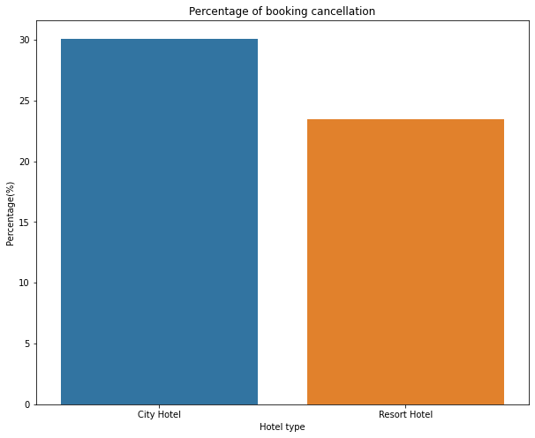
EDA
Results: Average lead time for resort hotel is high. It means people plan their trip too early. Usually people prefer resort hotels for longer stays. That’s why people plan early. Percentage of Booking cancellation rate is high for City hotels which almost 30 %. Average ADR for city hotel is high as compared to resort hotels. These City hotels are generating more revenue than the resort hotels.

Slide 15
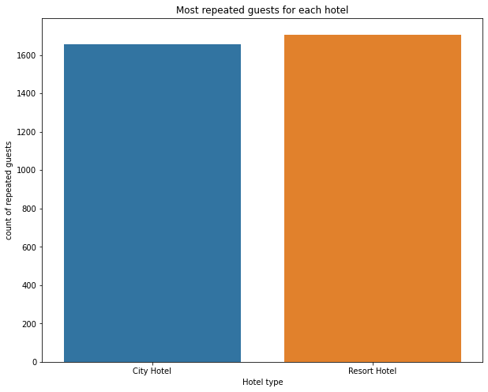
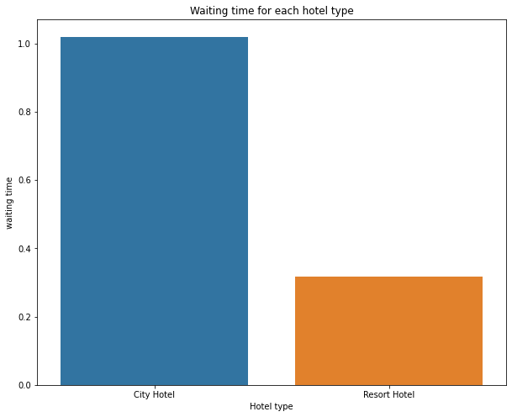
EDA
Results:
Resort hotels has the most repeated guests. In order to get increase the count of repeated guests hotel management need to take the valuable feedbacks from the guests and try to give good service
Waiting time period for City hotel is high as compared to resort hotels. That means city hotels are much busier than Resort hotels.

Slide 16
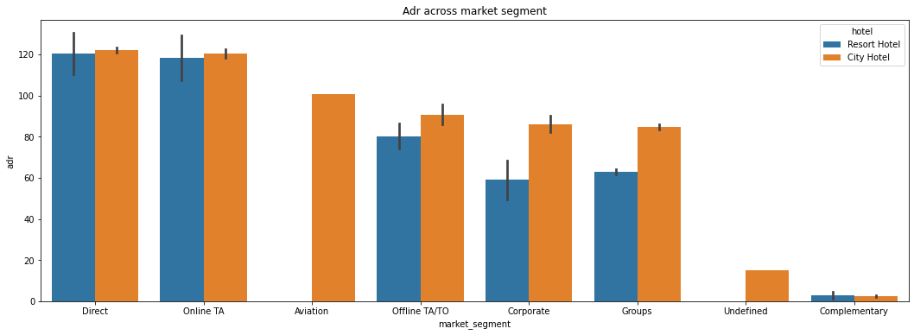
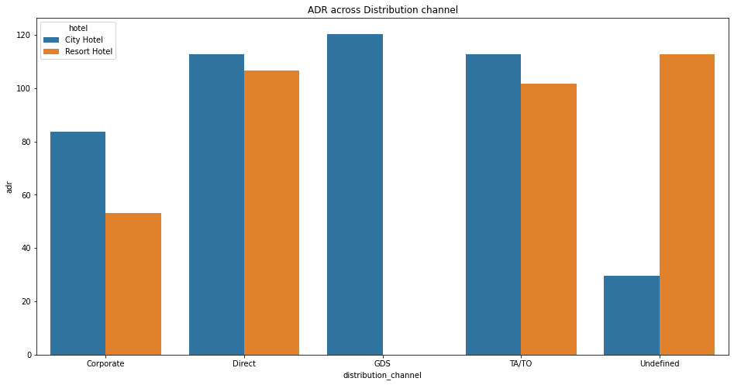
EDA
Results:
Distribution channel:
Direct' and 'TA/TO' has almost equal adr in both type of hotels which is high among other channelsGDS has high adr in 'City Hotel' type. GDS needs to increase Resort Hotel bookings. From this we can say that “Direct” and ‘TA/TO’ are generating more revenue than the other channels.
Market Segment:
Here “Direct” and ‘Online Travel Agency’ has high adr for both hotel types. Aviation segment needs to increase Resort hotel bookings

Slide 17
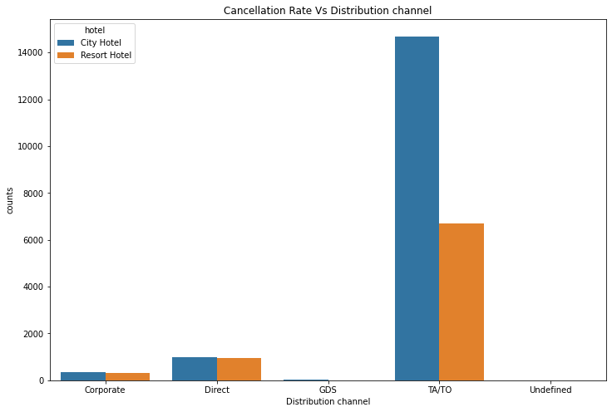
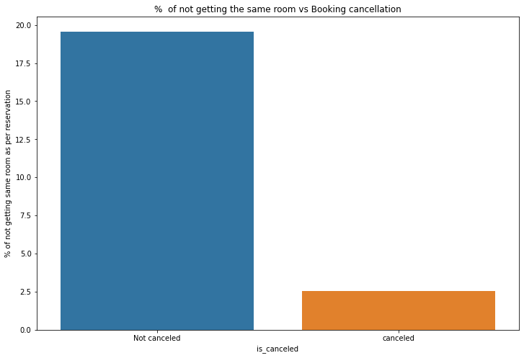
EDA
Results:
In "TA/TO", City hotels has the high cancellation rate compared to resort hotels
In "direct" both the hotels has almost same cancellation rate.
Its is clear that there is no much(2.5%) effect on cancellation of the bookings even if the guests are not assigned with rooms which they reserved during booking.

Slide 18
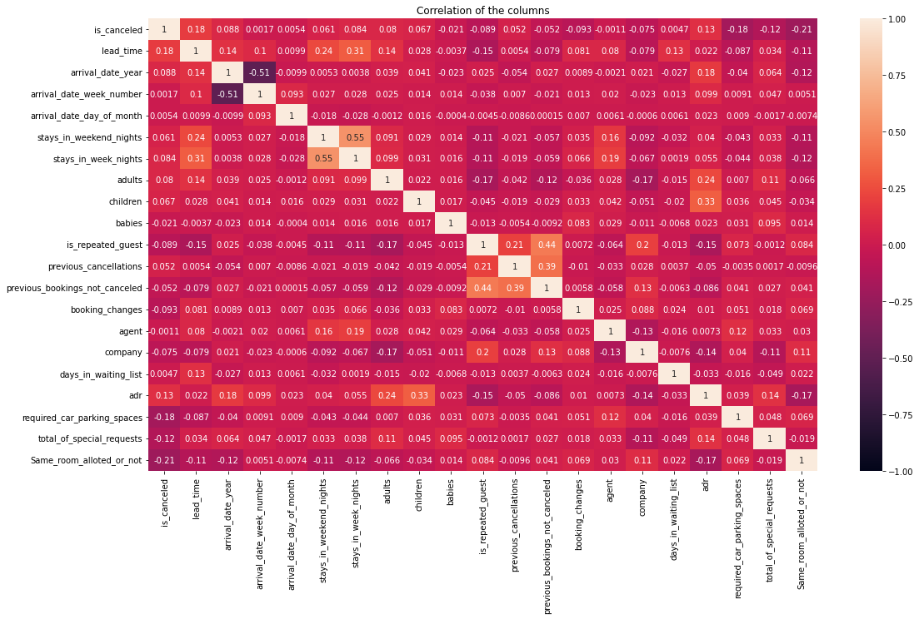
EDA
is_canceled and same_room_alloted_or_not are negatively corelated. That means customer is unlikely to cancel his bookings if he don't get the same room as per reserved room. We have visualized it above. lead_time and total_stay is positively correlated. That means more is the stay of customer more will be the lead time. Adults , childrens and babies are corelated to each other. That means more the people more will be adr . is_repeated guest and previous bookings not canceled has strong correlation. may be repeated guests are not more likely to cancel their bookings.

Slide 19
Conclusions:
City hotels are the most preferred hotel type by the guests. We can say City hotel is the busiest hotel.
27.5 % bookings were got cancelled out of all the bookings.
Only 3.9 % people were revisited the hotels. Rest 96.1 % were new guests. Thus retention rate is low.
The percentage of 0 changes made in the booking was more than 82 %. Percentage of Single changes made was about 10%.
Most of the customers (91.6%) do not require car parking spaces.
79.1 % bookings were made through TA/TO (travel agents/Tour operators).
BB( Bed & Breakfast) is the most preferred type of meal by the guests.
Maximum number of guests were from Portugal, i.e. more than 25000 guests.
Most of the bookings for City hotels and Resort hotel were happened in 2016.
Resort hotels have the most repeated guests.
Waiting time period for City hotel is high as compared to resort hotels. That means city hotels are much busier than Resort hotels.
Its is clear that there is no much(2.5%) effect on cancellation of the bookings even if the guests are not assigned with rooms which they reserved during booking.

Slide 20


